Slide 1
Teaching Math with XR
The proposed session will provide teaching tips and practices to create XR-based lessons to enhance Math instruction. Topics will include CreatiCode, Blender, and Geogebra. Mathematics is the language we use to explain our universe. XR allows students to develop that language in a very real way. Included grade levels 6 - 12 and a resource download.

Slide 2
Welcome to the XR Lobby

Slide 3
Definitions
Notes:
"What is XR? Well, it stands for Extended Reality... and it's also what a pirate says when he can't find his VR headset!"

Slide 4
XR
AR – Augmented Reality
VR – Virtual Reality
MR – Mixed Reality
Notes:
XR- is a catch-all term to refer to augmented reality (AR), virtual reality (VR), and mixed reality (MR).

Slide 5
AR
Augmented reality (AR) A User sees a digital layer onto the real world.

Slide 6
VR
Virtual reality (VR)
A User enters a computer-generated simulation, with the equipment providing an essential role.

Slide 7
MR
Mixed reality (MR)
A User interacts with the real world in the virtual spaces and with virtual objects in the real world

Slide 8
Augmented Reality
Mathematical Modeling and Measuring
Notes:
Augmented reality (AR) A User sees a digital layer onto the real world.

Slide 9
LAB
Notes:
Kiss Lab
Learning Goals – Volume of a cone, Volume of pyramid, Approximations of Volume (limits in calculus)
Model a Hershey Kiss using different sided pyramids to get close to an approximation of volume - https://www.geogebra.org/3d/uyw2ttb2
Create some variables-
Diameter[.01 1], Scale [1,10], number sides [4,50]
2) Create some calculated values
diameterScaled (Diameter/Scale)
circumference = diameterScaled* pi
3) Make a polygon using the following calculations
poly1 = Polygon ((0,0-(circumference/(2*numberOfSides)),0), (0,0+(circumference/(2*numberOfSides)),0),numberOfSides,xOyPlane)
The resulting value is the area of the base
4) Create a Pyramid based on the poly1
b = Pyramid(poly1,diameterScaled)
5) Calculate the Volume
Volume = b Scale^3
Use AR to line the Virtual Kiss up with the real Kiss
Have students open the KissLab on their device (or project your device to a screen)
Start the AR and set the scale value to the scale that is created in the AR window.
Have students manipulate the diameter till they have matched the size of the kiss using as many sides as they can.
Discuss the number of sides of the polygon (faces of the pyramid ) and how it increases the approximation
Read the volume number and talk about the actual volume of a kiss ( the diameter of the base of a Kiss is .819 inches and the diameter and height are the same. Therefore the volume is .14382 in^3 Reference: https://www.physicsforums.com/threads/volume-of-a-hershey-kiss.403646/
How about Jumbo kisses? Is there a relationship? Between the diameter and the volume as you go to bigger kisses
The Diameter and height of a Hershey kiss are the same.
–Source of idea - Modeling the real-world using AR - https://www.youtube.com/watch?v=bWNFvJ2oQwY

Slide 10
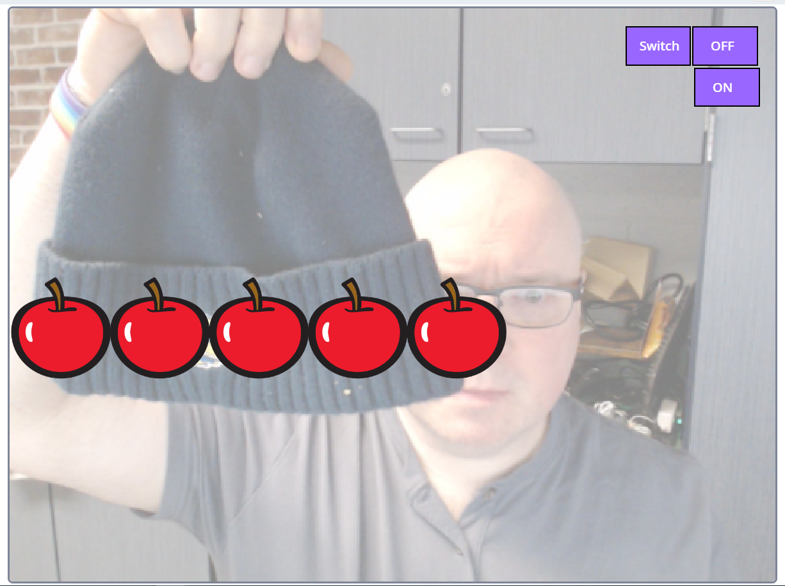
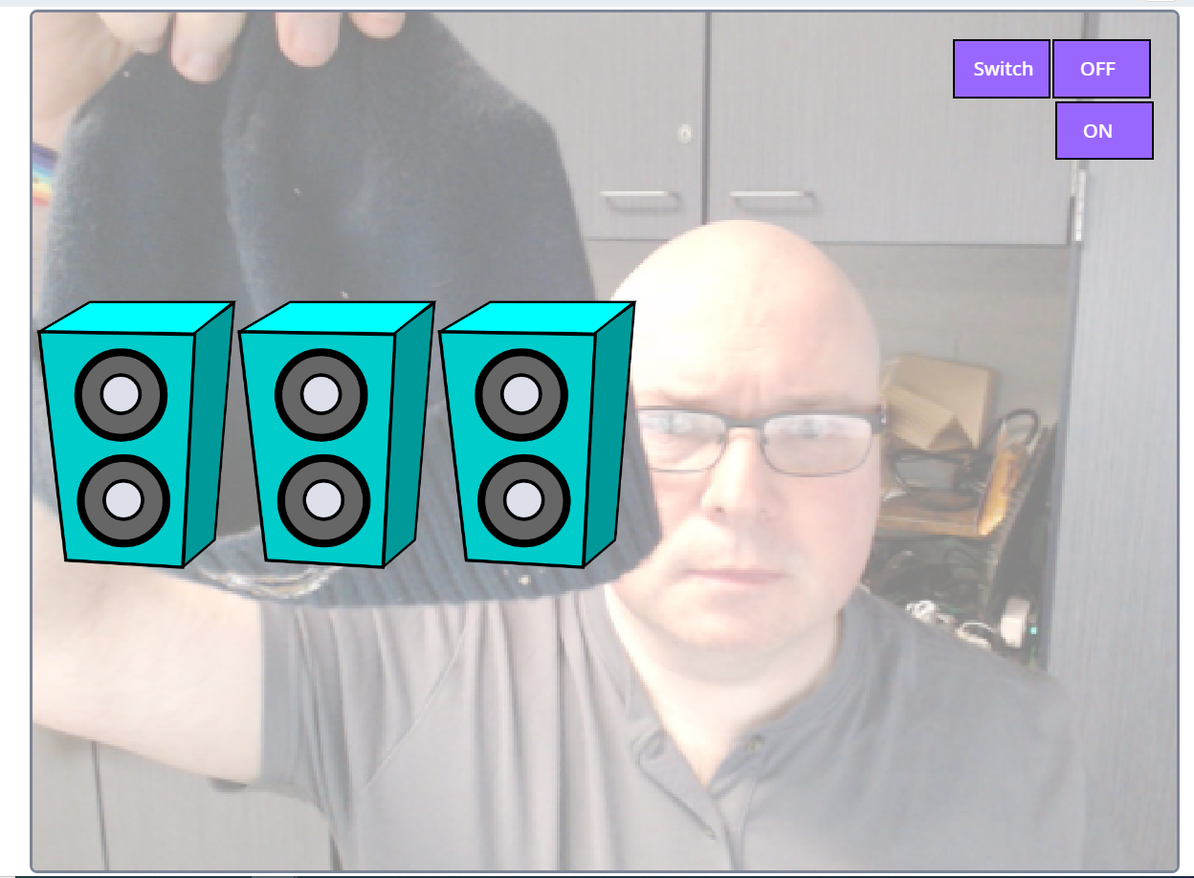
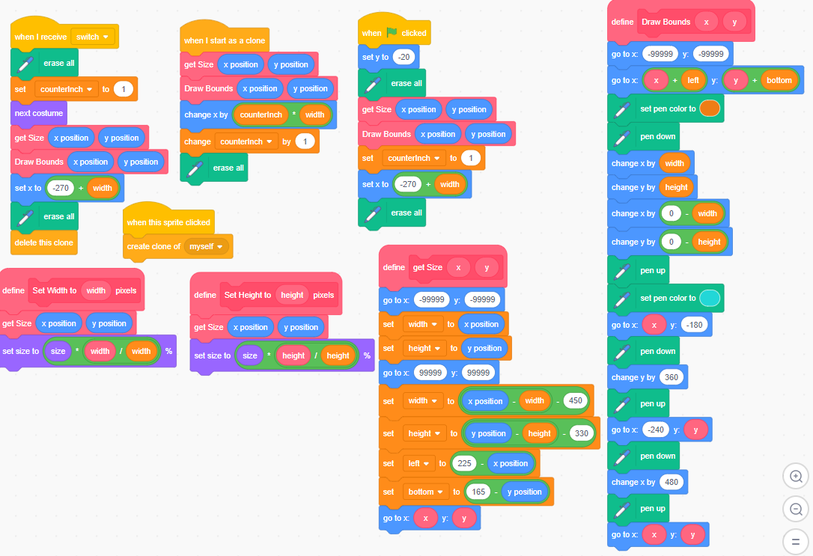
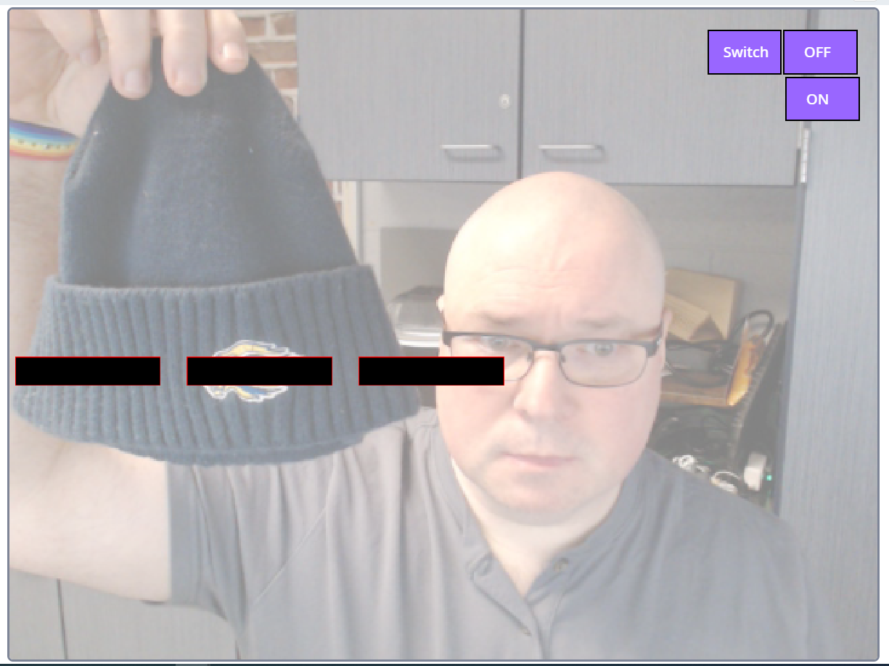
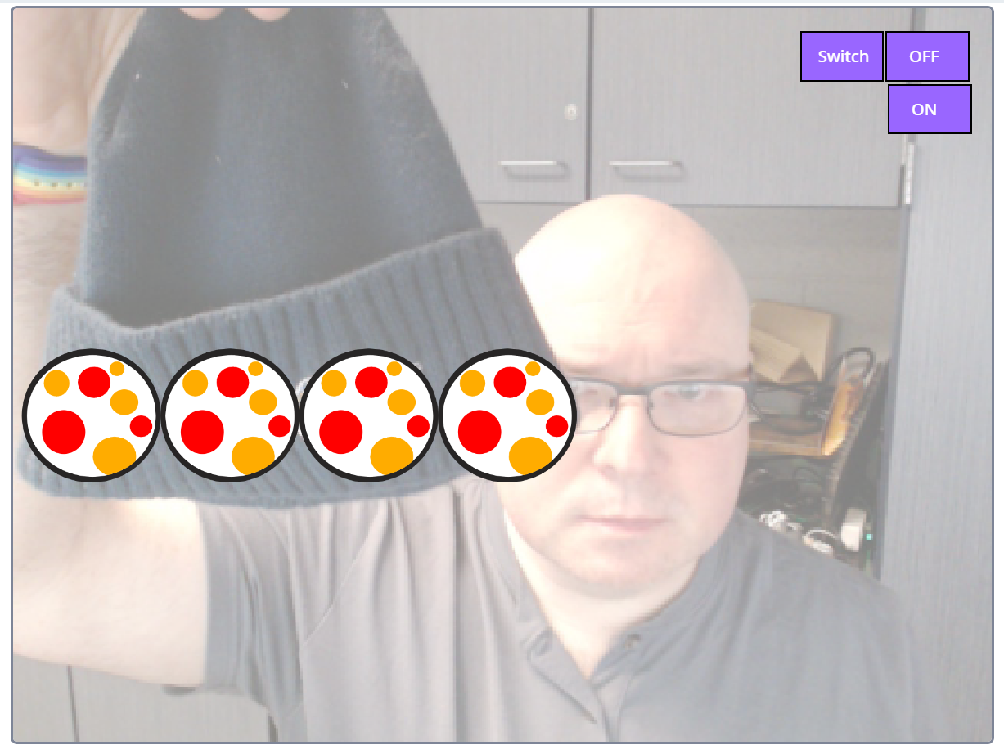
Measuring from Scratch LAB
Notes:
- MS - scratch coding and video overlay measuring with virtual devices add a 3d object and see how many shoes long something is… unit conversion
https://scratch.mit.edu/projects/949635648
Scale Stickers – turn on scratch camera. Align the scale sticker that has a length of 1in with the legend sprite. (match it to a real object that is 1in) Then 1in will equal 1 legend sprite.

Slide 11
Virtual Reality
Manipulation of models and Probability study
Notes:
Virtual reality (VR) A User enters a computer-generated simulation, with the equipment providing an essential role.

Slide 12

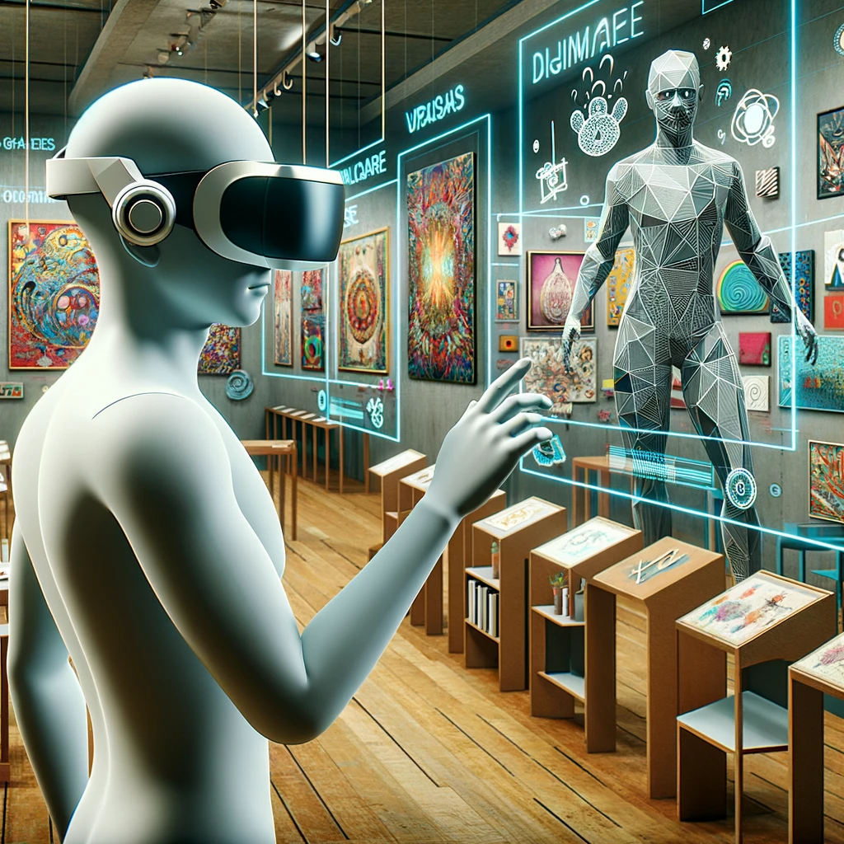
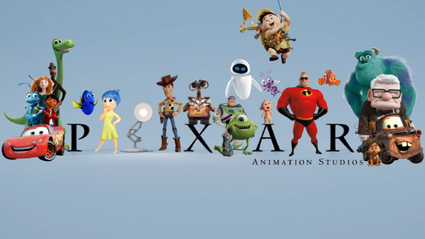

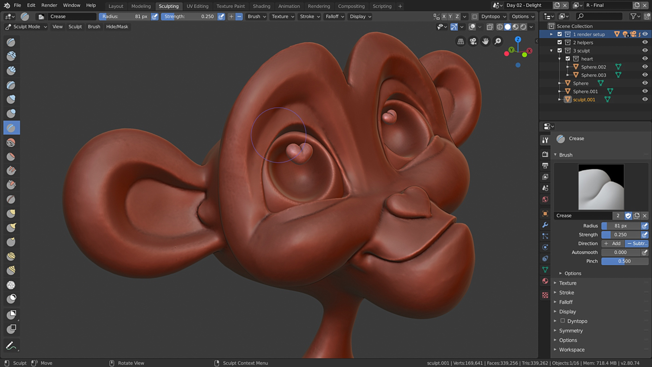
PBL –Virtual Student Gallery
Notes:
HS Midpoint - > subdivision in blender and the virtual gallery – Pixar lesson – Kahn academy - https://www.khanacademy.org/computing/pixar/modeling-character

Slide 13

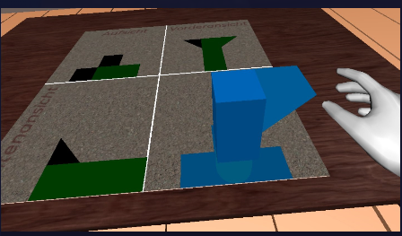


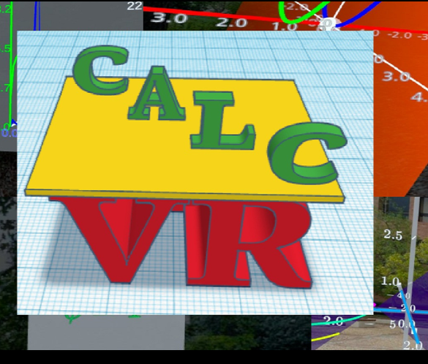
Notes:
MS - Probability … throw the snowball???
Calculus in Virtual Reality https://www.meta.com/experiences/6150858738287710/?utm_source=sidequest
NumberSense https://sidequestvr.com/app/6653/the-wonder-of-numbers-and-sounds
Solids and Shadows VR - https://sidequestvr.com/app/10913/solids-shadows-vr-beta
Sums https://sidequestvr.com/app/6642/number-cruncher https://www.youtube.com/watch?v=iKc6aXwO33Q
Side quest VR how to - https://sidequestvr.com/setup-howto

Slide 14
Mixed Reality
Creating Real models of Math and Chatting with Euclid.
Notes:
Mixed reality (MR) A User interacts with the real world in the virtual spaces and with virtual objects in the real world

Slide 15
Notes:
HS - 3D Printing with calculus – spinning shapes around an axis- with GeoGebra - calculus equations https://www.geogebra.org/m/mmfyj45b
Function(sin(x) + 2,-3.14,3.14)
Z = sqrt((f(x)^2-y^2)
Z = -sqrt((f(x)^2-y^2)

Slide 16
Notes:
MS– chat with Euclid Creaticode translate into languages https://planet.mblock.cc/project/3047567

Slide 17
One More thing…
ChatGPt can write your code for you.

Slide 18
ChatGPT Writes Unity
Unity Spheres Target Game

Slide 19
Contact
tmclaughlin@nhsd.org
Notes:
Here is my contact info in case you want to have a coffee break on Mars without leaving our classrooms!

Slide 20
Credits
Images produced in ChatGPT using DALL-E 3

Slide 21
Two levels and Three types of XR (extended reality)
High School Geometry –
VR - Gallery
MR - Printing out Surface Revolutions.
AR - Modeling the Real world
Middle School –
VR Probability … throw the snowball???
MR - Chat with Euclid Creaticode
AR scratch coding and video overlay measuring
Notes:
High School: VR - Midpoint - > subdivision in blender and the virtual gallery – Pixar lesson – Kahn academy - extension
MR – 3D Printing with calculus – spinning shapes around an axis- with GeoGebra - calculus equations https://www.geogebra.org/m/mmfyj45b
Function(sin(x) + 2,-3.14,3.14)
Z = sqrt((f(x)^2-y^2)
Z = -sqrt((f(x)^2-y^2)
AR – Modeling the real-world using AR - https://www.youtube.com/watch?v=bWNFvJ2oQwY
Middle School –
VR - Probability … throw the snowball???
MR – chat with Euclid Creaticode translate into languages https://planet.mblock.cc/project/3047567
AR – scratch coding and video overlay measuring with virtual devices add a 3d object and see how many shoes long something is… unit conversion
Could GeoGebra with a picture be Mixed Reality??? https://www.geogebra.org/m/jhcywuqw
AR - https://play.creaticode.com/projects/651f1b83fc9a5a6d148cd584?version=1
VR – Using Unity along with ChatGPT to program
HS - Using GeoGebra Classic:
Open GeoGebra Classic: Navigate to the GeoGebra Classic website and select the "3D Graphics" view.
Input Function: Use the input bar to enter the function that represents the curve you want to rotate. For example, you could type f(x) = x^2.
Define Axis of Rotation: Create the axis of rotation, which could be a line like the x-axis (y=0) or another line (y=x, etc.).
Create Solid of Revolution: You can create the solid by entering a Surface command. For example, to revolve f(x) = x^2 around the x-axis from x=a to x=b, you might enter Surface[ x^2, x, a, b, 0, 2pi ].
Manipulate: You can use sliders to change the limits of integration (a and b), which allows you to demonstrate how changing these parameters affects the resulting solid.
AR (Augmented Reality): GeoGebra Classic doesn't support AR natively, but the 3D graph can be exported as a 3D object file (like .obj or .stl). You can then use other software to view this object in AR.
Using GeoGebra Augmented Reality:
As of my last update in January 2022, GeoGebra did have an AR app, although it may not have all the capabilities of the full 3D Graphics view in GeoGebra Classic. However, it can still be a useful tool for demonstrating concepts in an interactive, 3D environment in the real world.
To use GeoGebra's AR capabilities for your specific needs might require exporting your model and using another tool to view it in AR, depending on the features available in the GeoGebra AR app at your time of use.
Given your interests in computer science and education, integrating tools like GeoGebra into your teaching could offer a hands-on learning experience for your students, making complex mathematical concepts more accessible.

